Slide 1
Blacktown Chinese Christian Church
Welcome to Our English Service 09.03.2025
English Service 9:45 – 11:00 am
Worship Songs: Passage: Speaker: Topic: Response Song: Announcements and Closing Prayer Benediction
Thrive Way Maker So Will I Genesis 21:1-7 TBA TBA TBA

Slide 2
BCCC english service

Slide 3

Please keep all phones on silent

Slide 4
Thrive
Mark Hall, Matthew West © 2014 Be Essential Songs (Admin. by Essential Music Publishing LLC) My Refuge Music (Admin. by Essential Music Publishing LLC) Matthew West (Combustion) (Admin. by Mushroom Music Publishing) Remaining portion is unaffiliated CCLI Licence No. 5485849 . CCLI Song number: 7006228

Slide 5
Verse 1
Here in this worn and weary land
Where many a dream has died
Like a tree planted by the water
We never will run dry

Slide 6
Pre-Chorus
So living water flowing through
God we thirst for more of You
Fill our hearts and flood our souls
With one desire

Slide 7
Chorus
Just to know You and
To make You known
We lift Your name on High
Shine like the sun make darkness run and hide

Slide 8
Chorus
We know we were made for so much more
Than ordinary lives
It's time for us to more than just survive
We were made to thrive

Slide 9
Verse 2
Into Your word we're digging deep
To know our Father's heart
Into the world we're reaching out
To show them who You are

Slide 10
Pre-Chorus
So living water flowing through
God we thirst for more of You
Fill our hearts and flood our souls
With one desire

Slide 11
Chorus
Just to know You and
To make You known
We lift Your name on High
Shine like the sun make darkness run and hide

Slide 12
Chorus
We know we were made for so much more
Than ordinary lives
It's time for us to more than just survive
We were made to thrive

Slide 13
Bridge
Joy Unspeakable, Faith Unsinkable
Love Unstoppable, Anything is possible
Joy Unspeakable, Faith Unsinkable
Love Unstoppable, Anything is possible (x2)

Slide 14
Chorus
Just to know You and
To make You known
We lift Your name on High
Shine like the sun make darkness run and hide

Slide 15
Chorus
We know we were made for so much more
Than ordinary lives
It's time for us to more than just survive
We were made to thrive

Slide 16
Outro
We were made to thrive

Slide 17
Way Maker
CCLI Licence No: 5485849

Slide 18
Verse 1
You are here, moving in our midst
I worship You, I worship You
You are here, working in this place
I worship You, I worship You

Slide 19
Chorus
You are
Way maker, miracle worker
Promise keeper, light in the darkness
My God, that is who You are (x2)

Slide 20
Verse 2
You are here, touching every heart
I worship You, I worship You
You are here, healing every heart
I worship You, I worship You

Slide 21
Verse 3
You are here, turning lives around
I worship You, I worship You
You are here, mending every heart
I worship You, I worship You

Slide 22
Chorus
You are
Way maker, miracle worker
Promise keeper, light in the darkness
My God, that is who You are

Slide 23
Chorus
Way maker, miracle worker
Promise keeper, light in the darkness
My God, that is who You are

Slide 24
Chorus
You are
Way maker, miracle worker
Promise keeper, light in the darkness
My God, that is who You are

Slide 25
Chorus
Way maker, miracle worker
Promise keeper, light in the darkness
My God, that is who You are

Slide 26
Refrain
That is who You are
That is who You are
That is who You are
That is who You are

Slide 27
Bridge
Even when I don't see it, You're working
Even when I don't feel it, You're working
You never stop, You never stop working
You never stop, You never stop working (x4)

Slide 28
Chorus
You are
Way maker, miracle worker
Promise keeper, light in the darkness
My God, that is who You are

Slide 29
Chorus
Way maker, miracle worker
Promise keeper, light in the darkness
My God, that is who You are

Slide 30
Outro
That is who You are
That is who You are
That is who You are
That is who You are

Slide 31
So Will I (100 Billion X)
Benjamin Hastings, Joel Houston, Michael Fatkin © 2017 Hillsong Music Publishing Australia CCLI Licence No. 5485849 . CCLI Song number: 7084123

Slide 32
Verse 1
God of creation
There at the start
Before the beginning of time

Slide 33
Verse 1
With no point of reference
You spoke to the dark
And fleshed out the wonder of light

Slide 34
Chorus 1
And as You speak
A hundred billion galaxies are born
In the vapour of Your breath, the planets form
If the stars were made to worship so will I

Slide 35
Chorus 1
I can see Your heart in everything You've made
Every burning star a signal fire of grace
If creation sings Your praises so will I

Slide 36
Verse 2
God of Your promise
You don't speak in vain
No syllable empty or void

Slide 37
Verse 2
For once You have spoken
All nature and science
Follow the sound of Your voice

Slide 38
Chorus 2
And as You speak
A hundred billion creatures catch Your breath
Evolving in pursuit of what You said
If it all reveals Your nature so will I

Slide 39
Chorus 2
I can see Your heart in everything You say
Every painted sky a canvas of Your grace
If creation still obeys You so will I

Slide 40
Post-chorus
So will I
So will I

Slide 41
Bridge
If the stars were made to worship so will I
If the mountains bow in reverence so will I
If the oceans roar Your greatness so will I
For if everything exists to lift You high so will I

Slide 42
Bridge
If the wind goes where You send it so will I
If the rocks cry out in silence so will I
If the sum of all our praises still falls shy
Then we'll sing again a hundred billion times

Slide 43
Verse 3
God of salvation
You chased down my heart
Through all of my failure and pride

Slide 44
Verse 3
On a hill You created
The light of the world
Abandoned in darkness to die

Slide 45
Chorus 3
And as You speak
A hundred billion failures disappear
Where You lost Your life so I could find it here
If You left the grave behind You so will I

Slide 46
Chorus 3
I can see Your heart in everything You've done
Every part designed in a work of art called love
If You gladly chose surrender so will I

Slide 47
Chorus 3
I can see Your heart eight billion different ways
Every precious one a child You died to save
If You gave Your life to love them so will I

Slide 48
Tag
Like You would again a hundred billion times
But what measure could amount to Your desire
You're the One who never leaves the one behind

Slide 49
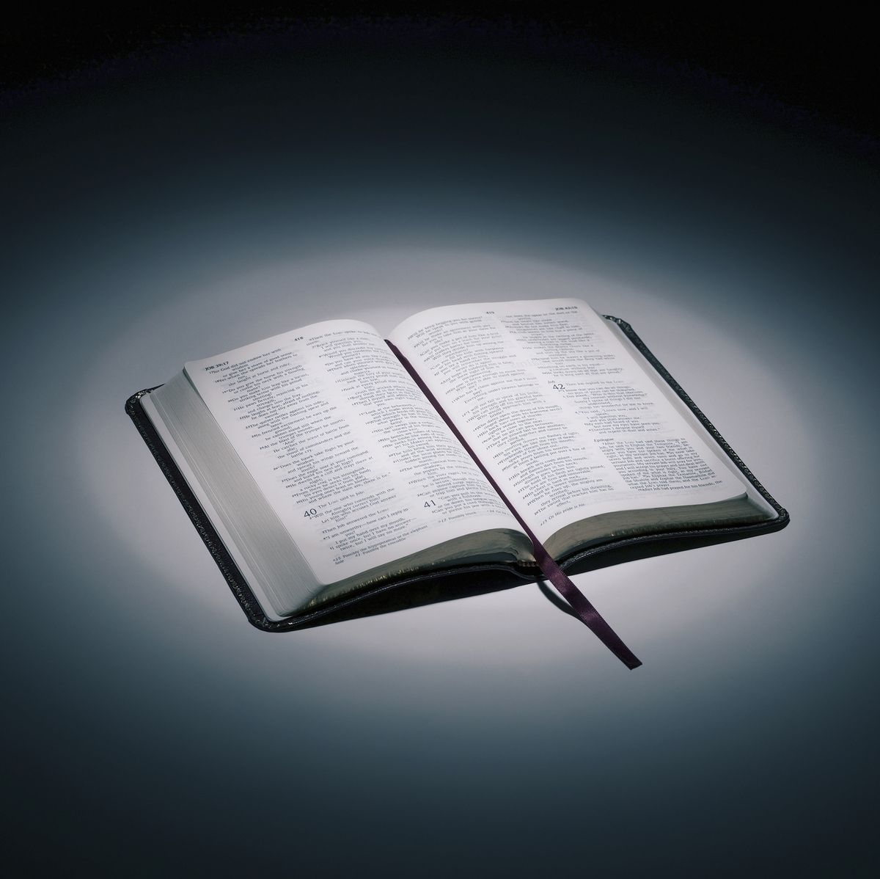
Bible reading

Slide 50
Genesis 21:1-7 (NIV)
Now the Lord was gracious to Sarah as he had said, and the Lord did for Sarah what he had promised. ² Sarah became pregnant and bore a son to Abraham in his old age, at the very time God had promised him.

Slide 51
Genesis 21:1-7 (NIV)
³ Abraham gave the name Isaac to the son Sarah bore him. ⁴ When his son Isaac was eight days old, Abraham circumcised him, as God commanded him.

Slide 52
Genesis 21:1-7 (NIV)
⁵ Abraham was a hundred years old when his son Isaac was born to him.
⁶ Sarah said, “God has brought me laughter, and everyone who hears about this will laugh with me.”

Slide 53
Genesis 21:1-7 (NIV)
⁷ And she added, “Who would have said to Abraham that Sarah would nurse children? Yet I have borne him a son in his old age.”

Slide 54
Scripture quotations taken from The Holy Bible, New International Version® NIV®
Copyright © 1973, 1978, 1984, 2011 by Biblica, Inc.
Used with permission. All rights reserved worldwide.

Slide 55
Announcements

Slide 56





Account name: Blacktown Chinese Christian Church
Account number: 4216 50263
Offering
BSB: 112 - 879
Please put in "offering" as the reference
The offering box is available at the back of the hall

Slide 57
Prayer points

Slide 58
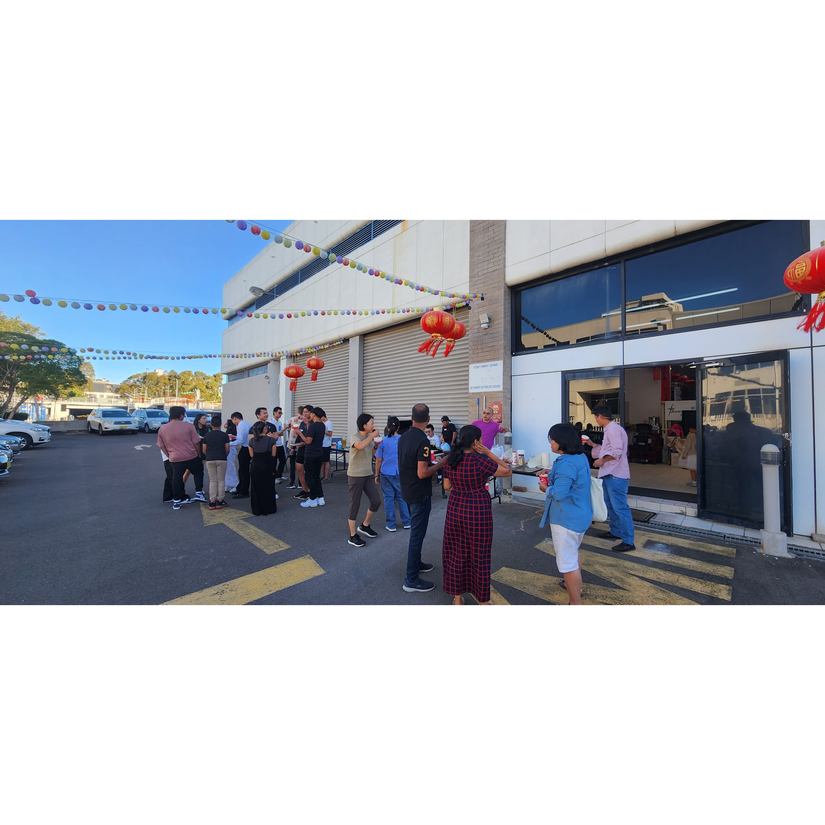
Mingle time!

